Slide 1
Alta Performance com Java
Java OO com Alta Performance

Slide 2
Apresentação
Atuo na área de TI desde 1996 e com Java e aplicações corporativas desde 2004. Tive a oportunidade de participar de grandes projetos para clientes como: HP, EDS, Bosch, Mitsubhishi e para os Governos de Santa Catarina, São Paulo e Mato Grosso do Sul. Atualmente me encontro imerso na cultura Ágil e palestrando em importantes eventos como Javaneiros e Flisol.
@apedrina
pedrina.alisson@gmail.com
www.alissonpedrina.wordpress.com

Slide 3
O curso
Como nasceu a ideia
Como evoluiu
Para onde vai

Slide 4
Conteúdo
A Tecnologia Java
História do Java
Java na atualidade
Java e mercado de trabalho
Como surfar a atual onda
Performance
Arquitetura da JVM
Modelo de Memória
Garbage Collector
Classloader

Slide 5
Conteúdo
JIT
Engine de execução
JDK Tools
MAT e GCMV
Usando a memória
Microbenchmark
Web Performance
Agent
AOP
Manifesto Ágil
Scrum
XP
Clean code

Slide 6
The Java Technology

Slide 7

What is?
Language
Plataform
JVM

Slide 8
History of Java Technology
http://www.javatpoint.com/history-of-java

Slide 9
Green Team
James Gosling, Mike Sheridan, and Patrick Naughton initiated the Java language project in June 1991. The small team of sun engineers called Green Team.
Originally designed for small, embedded systems in electronic appliances like set-top boxes.
Firstly, it was called "Greentalk" by James Gosling and file extension was .gt.
After that, it was called Oak and was developed as a part of the Green project.

Slide 10
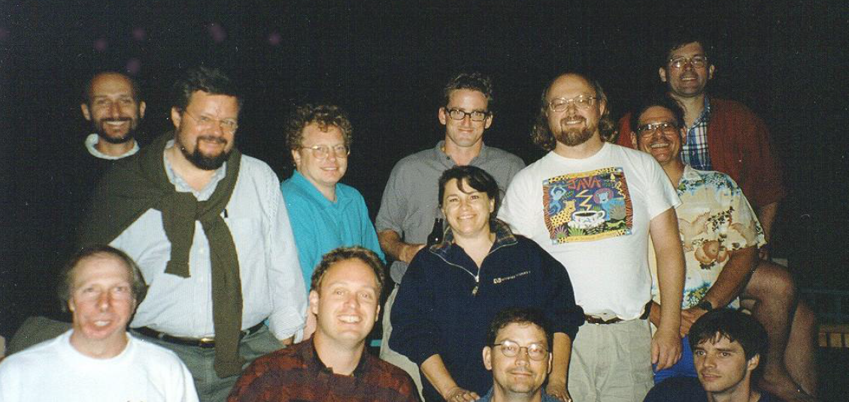
Green Team

Slide 11
Why OAK?
Oak is a symbol of strength and choosen as a national tree of many countries like U.S.A., France, Germany, Romania etc.
In 1995, Oak was renamed as "Java" because it was already a trademark by Oak Technologies.

Slide 12
Why Java?
The team gathered to choose a new name. The suggested words were "dynamic", "revolutionary", "Silk", "jolt", "DNA" etc. They wanted something that reflected the essence of the technology: revolutionary, dynamic, lively, cool, unique, and easy to spell and fun to say.
According to James Gosling "Java was one of the top choices along with Silk". Since java was so unique, most of the team members preferred java.
Java is an island of Indonesia where first coffee was produced (called java coffee).
Originally developed by James Gosling at Sun Microsystems (which is now a subsidiary of Oracle Corporation) and released in 1995.

Slide 13
Nothing new
A base Object class from which all classes descend? Smalltalk.
Strong static type-checking at compile time? Ada.
Multiple interface, single implementation inheritance? Objective-C.
Inline documentation? CWeb.
Cross-platform virtual machine and byte code with just-in-time compilation? Smalltalk again, especially Sun’s Self dialect.
Garbage collection? Lisp.
Primitive types and control structures? C.

Slide 14
Versions
JDK Alpha and Beta (1995)
JDK 1.0 (January 23, 1996) | Oak
JDK 1.1 (February 19, 1997)
J2SE 1.2 (December 8, 1998) | Playground
J2SE 1.3 (May 8, 2000) | Kestrel (hotspot)
J2SE 1.4 (February 6, 2002) | Merlin (jcp) jsr59
J2SE 5.0 (September 30, 2004) | Tiger
Java SE 6 (December 11, 2006) | Mustang
Oracle 2010
Java SE 7 (July 28, 2011) | Dolphin
Java SE 8 (March 18, 2014)

Slide 15
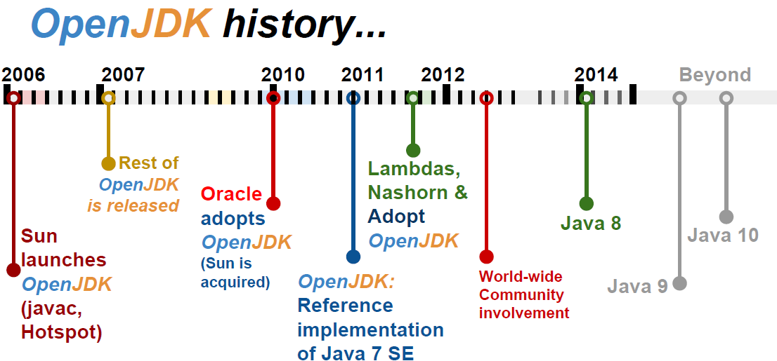
To promote and support community involvement in the development, adoption and evangelism of OpenJDK projects

Slide 16
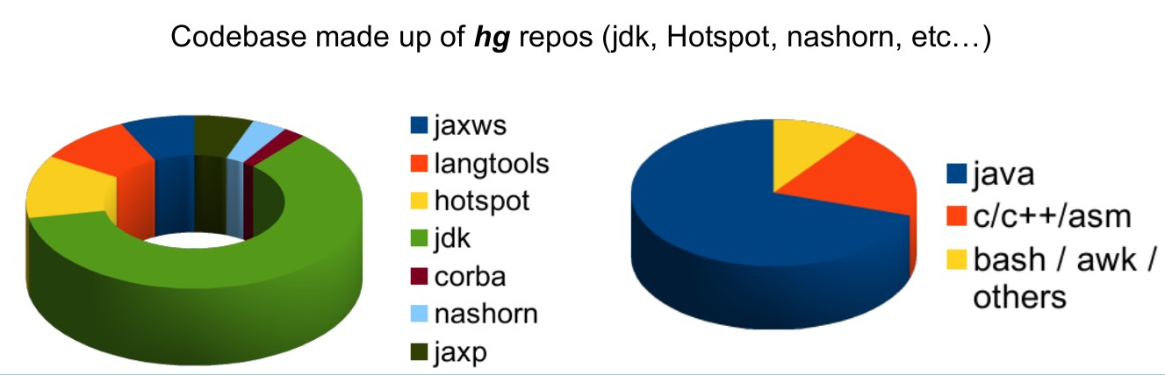
Codebase OpenJdk

Slide 17
Nowadays
Java now !!!

Slide 18
JCP and JSR
Welcome to jcp.org, home of the Java Community ProcessSM (JCPSM) Program. The JCP is the mechanism for developing standard technical specifications for Java technology. Anyone can register for the site and participate in reviewing and providing feedback for the Java Specification Requests (JSRs), and anyone can sign up to become a JCP Member and then participate on the Expert Group of a JSR or even submit their own JSR Proposals.

Slide 19
JDK Enhancement Proposal
The JDK Enhancement Proposal (or JEP) is a process drafted by Oracle Corporation for collecting proposals for enhancements to the Java Development Kit and OpenDK.

Slide 20
Meta-circular and dynamics languages
Maxine - JVM
Graal VM – compilador e interpretador
Jruby
Jython
Nashorn
Scala
Groovy

Slide 21
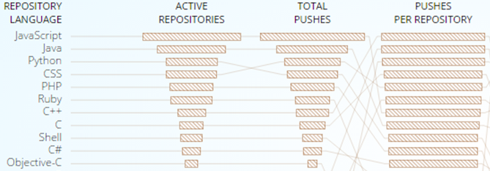
GitHub

Slide 22
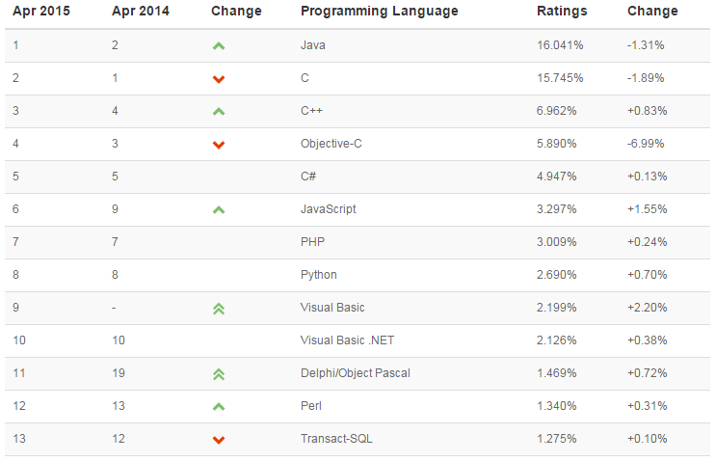
TIOBE checks more than 300 million lines of software code for its customers world-wide, real-time, each day.

Slide 23
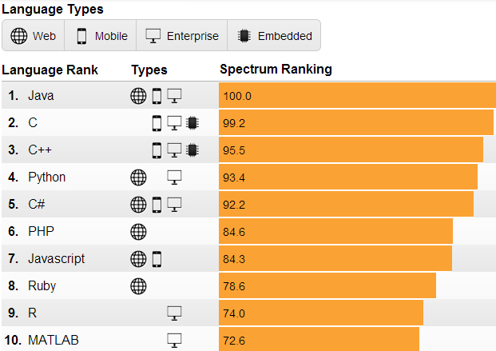
IEEE is the world's largest professional association dedicated to advancing technological innovation and excellence for the benefit of humanity.

Slide 24
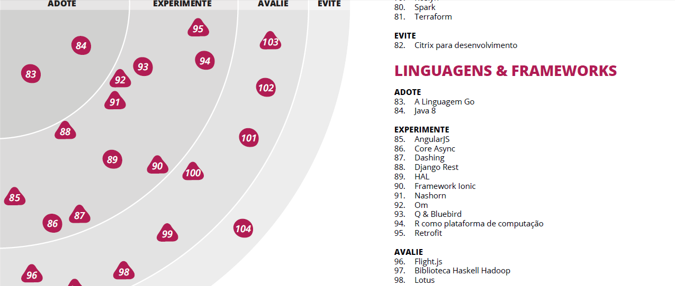
Radar thoughtworks

Slide 25
Market
In Brasil and in the world

Slide 26
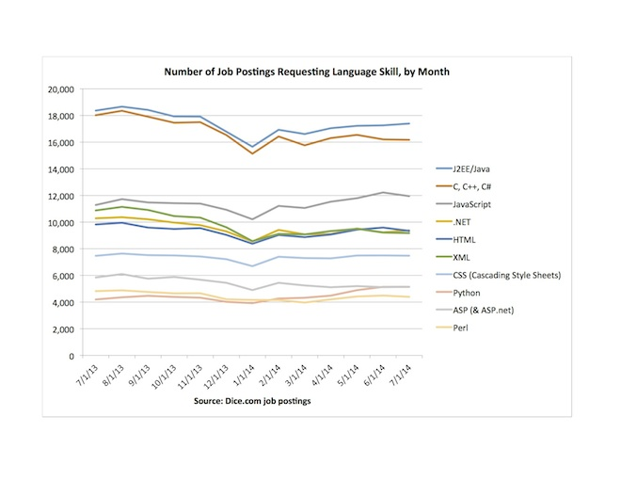
Dice.com

Slide 27
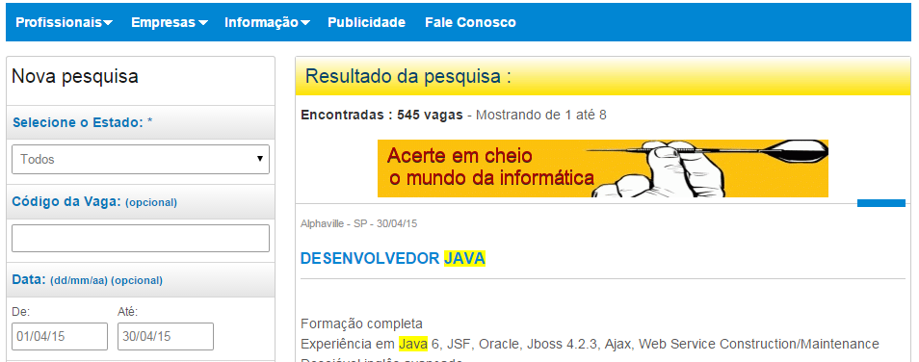
www.apinfo.com

Slide 28












Some companies

Slide 29
How to surf current wave

Slide 30
This makes the differences
Solid principles OO
Design Patterns
S.O.L.I.D
Clean code
Automated Testing
TDD
Agile manifesto

Slide 31
Performance

Slide 32

What is?
Performance scalability bottleneck

Slide 33



When testing?
Early
Afternoon
Balanced

Slide 34
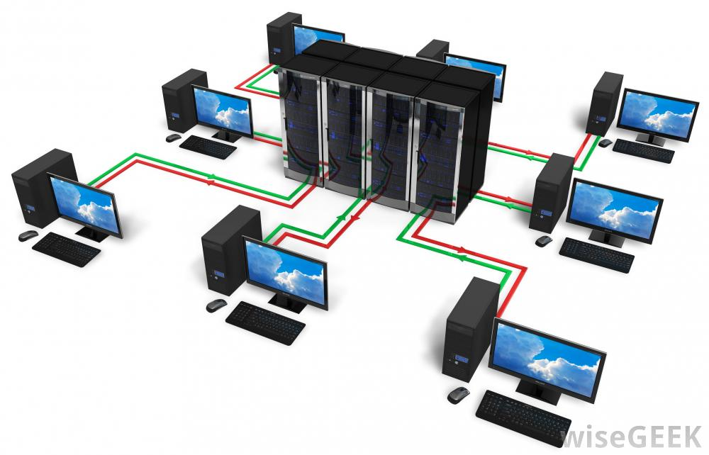

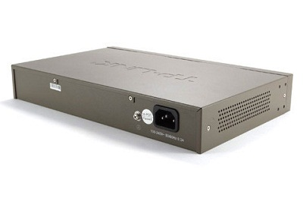
Where is bottleneck?

Slide 35
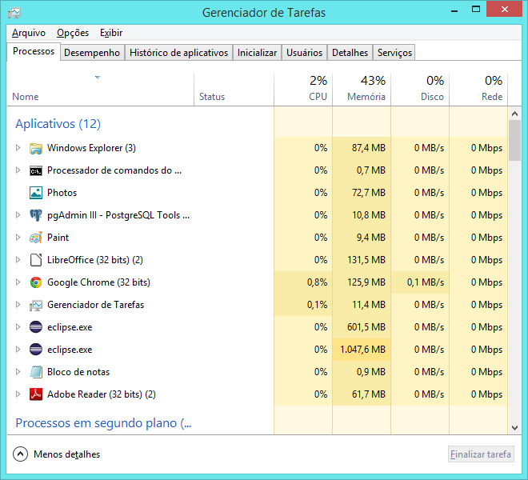
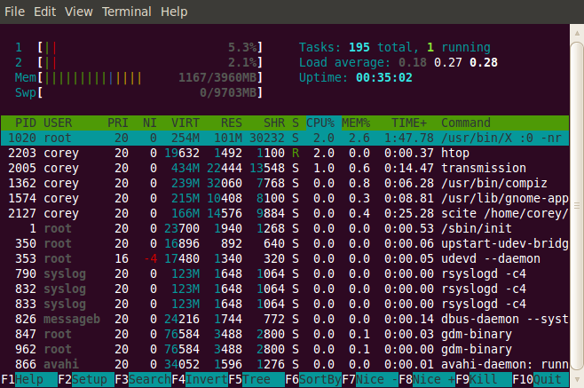
Tools

Slide 36
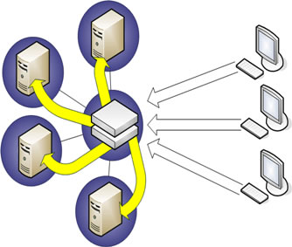
Tests
Real applications
Exact copy
Subsystems
Regression testing

Slide 37

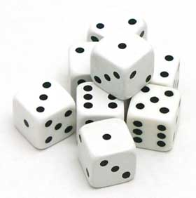
Which helps
Queuing theory
Probability

Slide 38
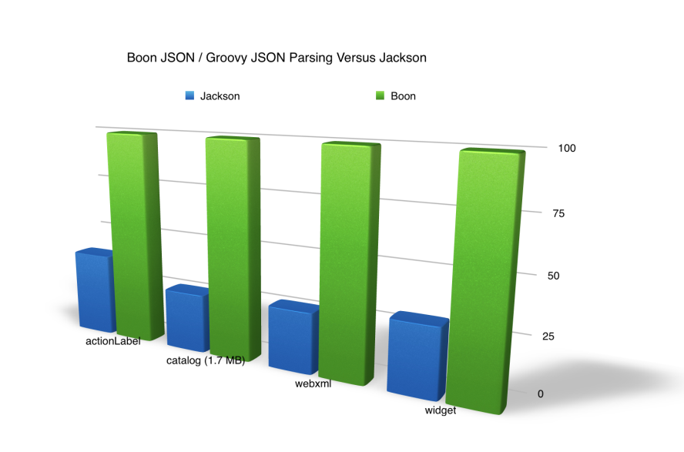
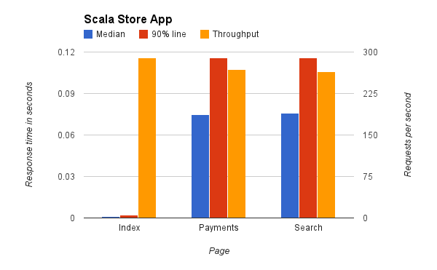
Benchmark
Microbenchmark
Macrobenchmark
Mesobenchmark

Slide 39
Which mesuare
Response Time
Batching
Latency
Throughput
Scalability
Stress Testing

Slide 40
Stress Testing
if you find yourself running tests for more than 24 hours you are doing a stress test.

Slide 41
Scalability
is the measure of how your system responds when additional hardware is added.

Slide 42
Throughput
transactions per second your application can handle (motivation / result of load testing). A typical enterprise application will have lots of users performing lots of different transactions. You should ensure that your application meets the required capacity of enterprise before it hits production.
Throughput
OPS/TPS /RPS and average time
Ex: 500ops at 0.5s x 400ops at 0.4s

Slide 43
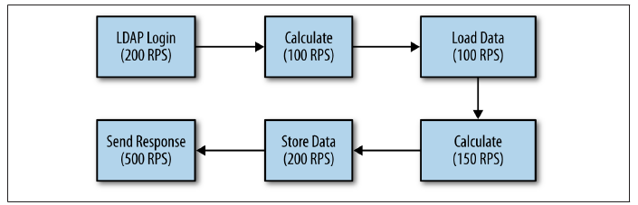
What is that?

Slide 44
Response Time
Amount of time system takes to process a request after it has received one. For instance you have API and you want to find how much time that API takes to execute once invoked, you are in fact measuring response time.
Think time
Média tempos somados dividido pelo número de request
Porcentagem 90%, 5%, etc

Slide 45
Latency
In simplest terms this is Remote Response time. For instance, you want to invoke a web service or access a web page. Apart from the processing time that is needed on the server to process your request, there is a delay involved for your request to reach to server. While referring to Latency, it’s that delay we are talking about.
Networking virtualization

Slide 46
Tips
Variability
Probability
Do not sacrifice solide principles of architecture in exchange for performance
Try to create good programs rather than fast, unless…

Slide 47
JVM Architectura

Slide 48
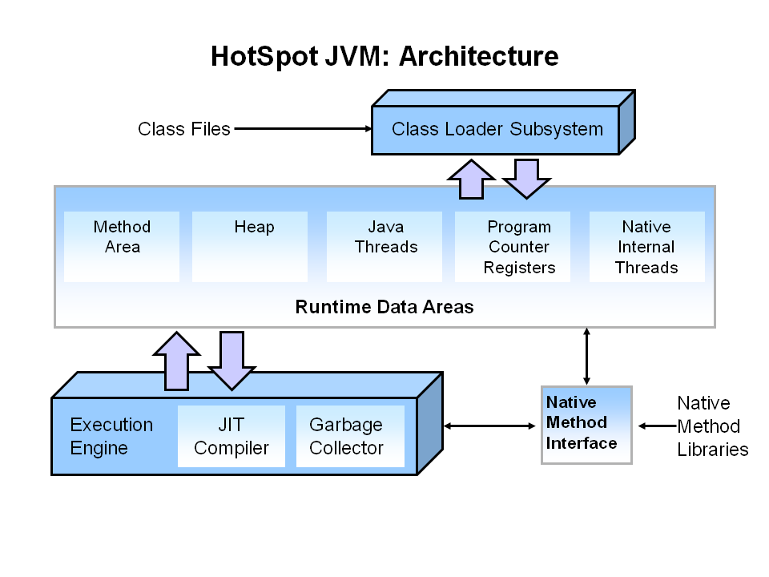
Overview

Slide 49
Memory model

Slide 50
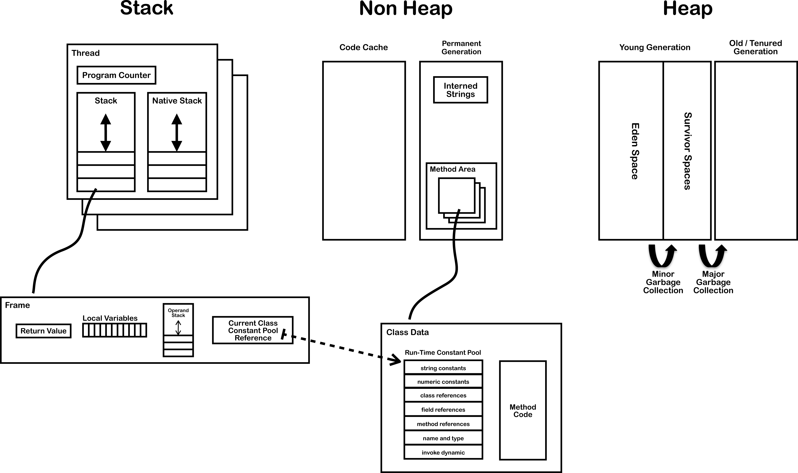
Modelo de memória

Slide 51
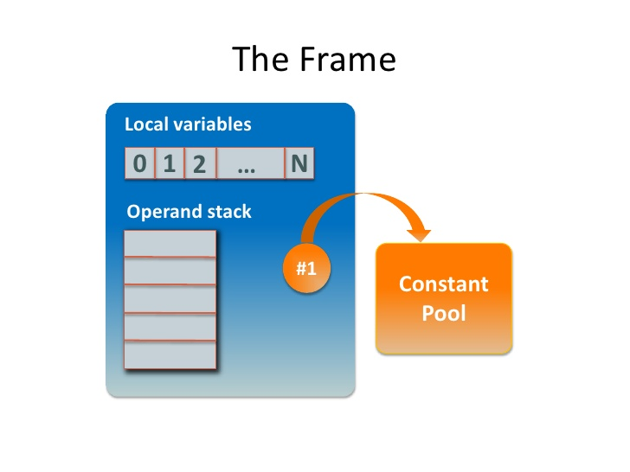

Slide 52
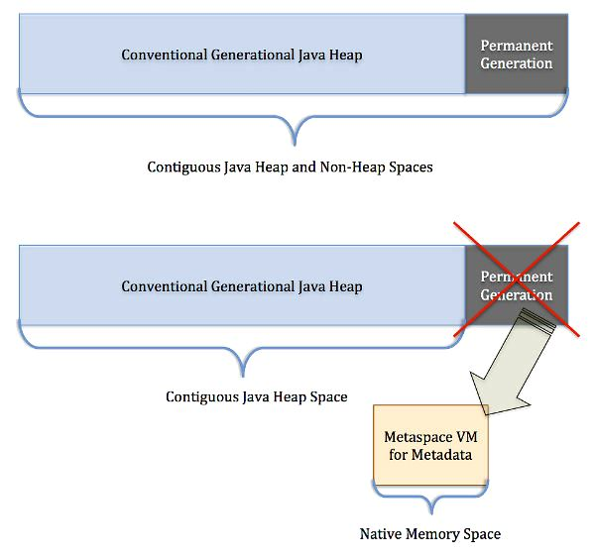

Slide 53
Out of memory errors
No native memory is available for the JVM.
The permgen (in Java 7 and earlier) or metaspace (in Java 8) is out of memory.
The Java heap itself is out of memory: the application has too many live objects for
the given heap size.
The JVM is spending too much time performing GC.

Slide 54
Flags that can help
-XX:+HeapDumpOnOutOfMemoryError
-XX:HeapDumpPath=<path>
-XX:+HeapDumpAfterFullGC
-XX:+HeapDumpBeforeFullGC
-XX:GCTimeLimit=N (default 98%)
-XX:GCHeapFreeLimit=N (default is 2%)
-XX:+UseGCOverheadLimit (default is true)

Slide 55
Garbage Collector

Slide 56
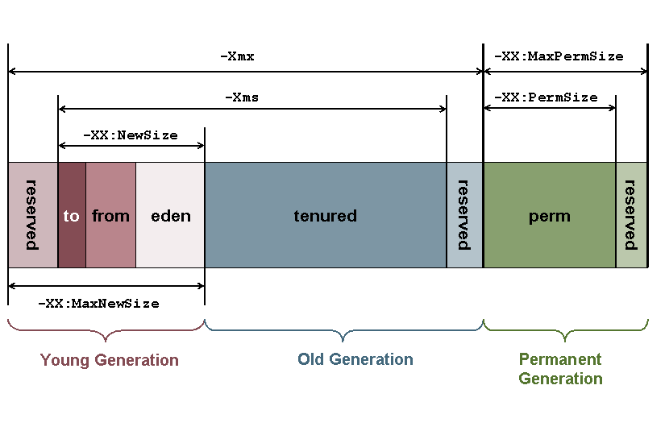
Garbage Collector

Slide 57
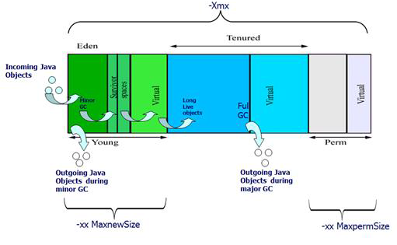

Slide 58
Kinds of GC
-XX:+UseSerialGC
-XX:+UseParallelGC
-XX:+UseConcMarkSweepGC
-XX:+UseG1GC

Slide 59
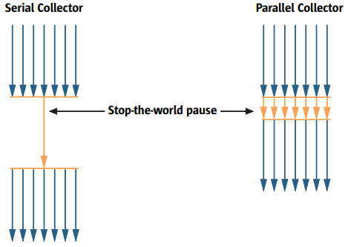

Slide 60
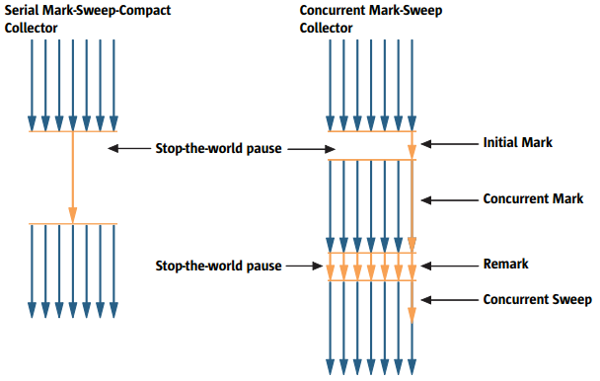

Slide 61
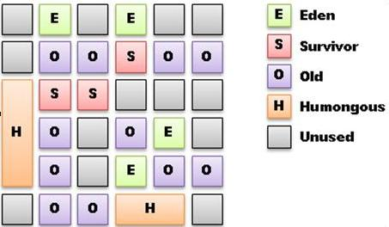
G1

Slide 62
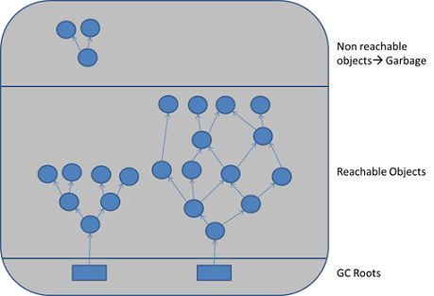
Java threads, jni references, static and local variables

Slide 63
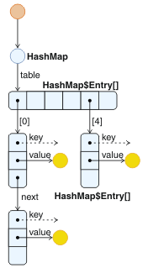

Slide 64
Size of Java instances variables
byte 1
char 2
short 2
int 4
float 4
long 8
double 8
reference 4 on 32-bit JVMs and 64-bit JVMs with heaps of less than 32 GB;
8 on 64-bit JVMs with large heaps

Slide 65
How much memory hold a object?
Shallow size
Deep size
Retained size

Slide 66
Compressed OOPS
32 or 64 bits?
32 bits for Heap at least 4GB (3.5 in pratice)

Slide 67
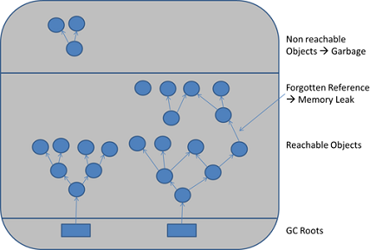
Memory leak

Slide 68
Flags
You need at least: – -XX:+PrintGCTimeStamps
Add -XX:+PrintGCDateStamps if you must know the time
– -XX:+PrintGCDetails
Preferred over -verbosegc as it's more detailed
Also useful: – -Xloggc:<file>
– Rotate GC Log, After Java 1.6_34 (or 1.7_2):
-XX:+UseGCLogFileRotation
-XX:NumberOfGCLogFiles=5
-XX:GCLogFileSize=10M

Slide 69
Classloader

Slide 70
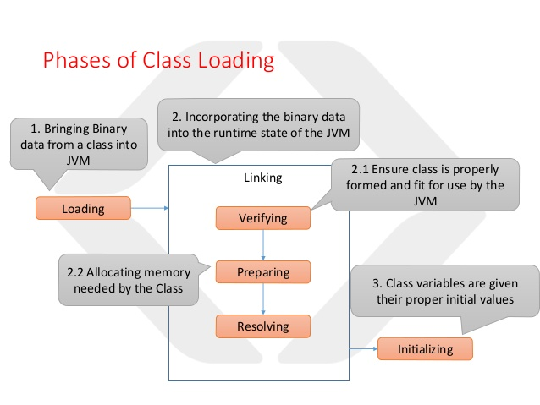

Slide 71
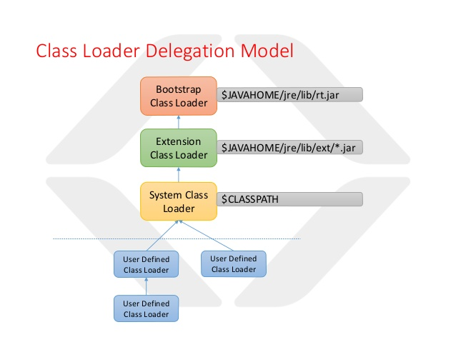

Slide 72
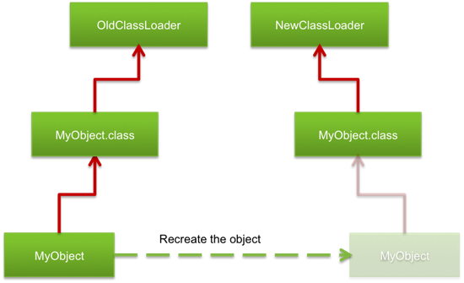
Reloading

Slide 73
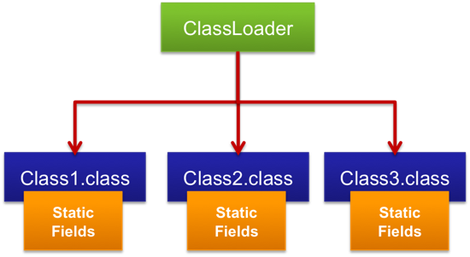
Retained

Slide 74
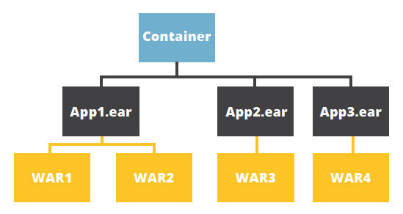
Java EE delegation model

Slide 75
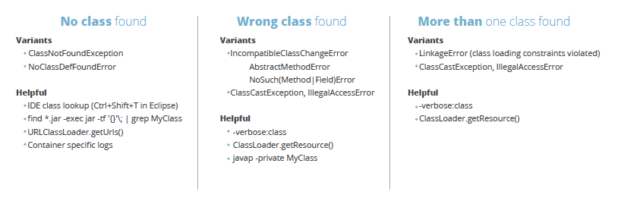
Errors and possible solutions

Slide 76
JIT

Slide 77
Modes
C1 -client
C2 –server
-XX:+TieredCompilation
-XX:+UnlockDiagnosticVMOptions
-XX:+LogCompilation
35 bytes or 325 to hotspot
-XX:MaxInlineSize=n
the hot threshold with ‑XX:FreqInlineSize=n
Reduce the invocation count by 50% in 30 seconds

Slide 78
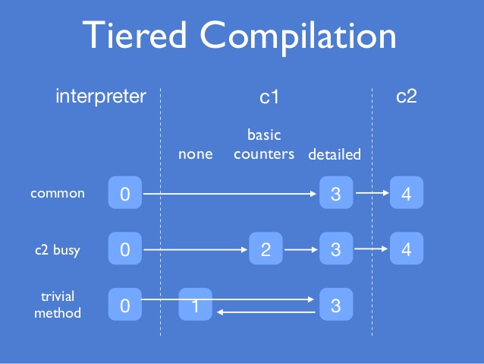

Slide 79
Just in time compilation
-XX:+PrintCompilation
-XX:ReservedCodeCacheSize=n
-XX:CompileThreshold=n
-XX:+UseCodeCacheFlushing
-XX:LogFile=mylogfile.log
Lukwarm
-Djava.compiler=none
JIT.pdf

Slide 80
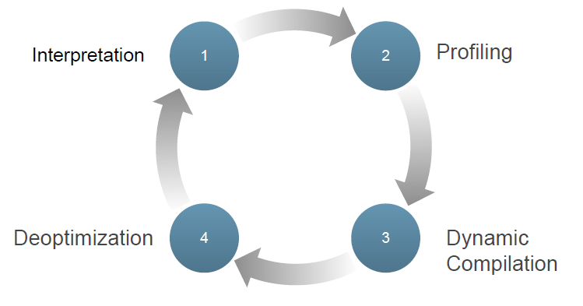

Slide 81
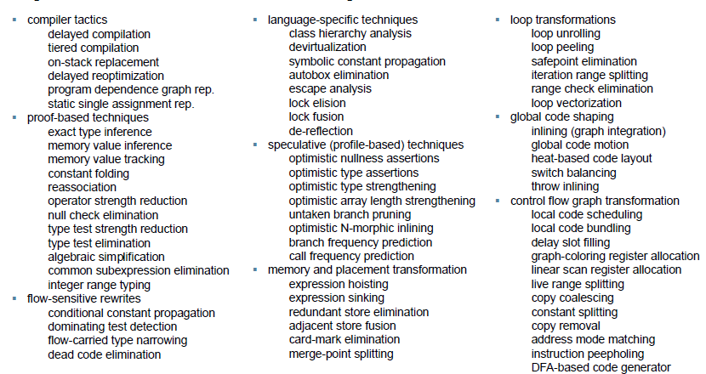

Slide 82
Inlining
int addAll(int max) {
int accum = 0;
for (int i = 0; i < max; i++) {
accum = add(accum, i);
}
return accum;
}
int add(int a, int b) { return a + b; }

Slide 83
Inlining
int addAll(int max) {
int accum = 0;
for (int i = 0; i < max; i++) {
accum = accum + i;
}
return accum;
}

Slide 84
Loop Unrolling
public void foo(int[] arr, int a) {
for (int i = 0; i < arr.length; i++) {
arr[i] += a;
}
}

Slide 85
Loop Unrolling
public void foo(int[] arr, int a) {
for (int i = 0; i < arr.length; i=i+4) {
arr[i] += a; arr[i+1] += a; arr[i+2] += a; arr[i+3] += a;
}
}

Slide 86
Lock Eliding
public void m1() {
List list = new ArrayList();
synchronized (list) {
list.add(someMethod());
}
}

Slide 87
Lock Eliding
public void m1() {
List list = new ArrayList();
list.add(someMethod());
}

Slide 88
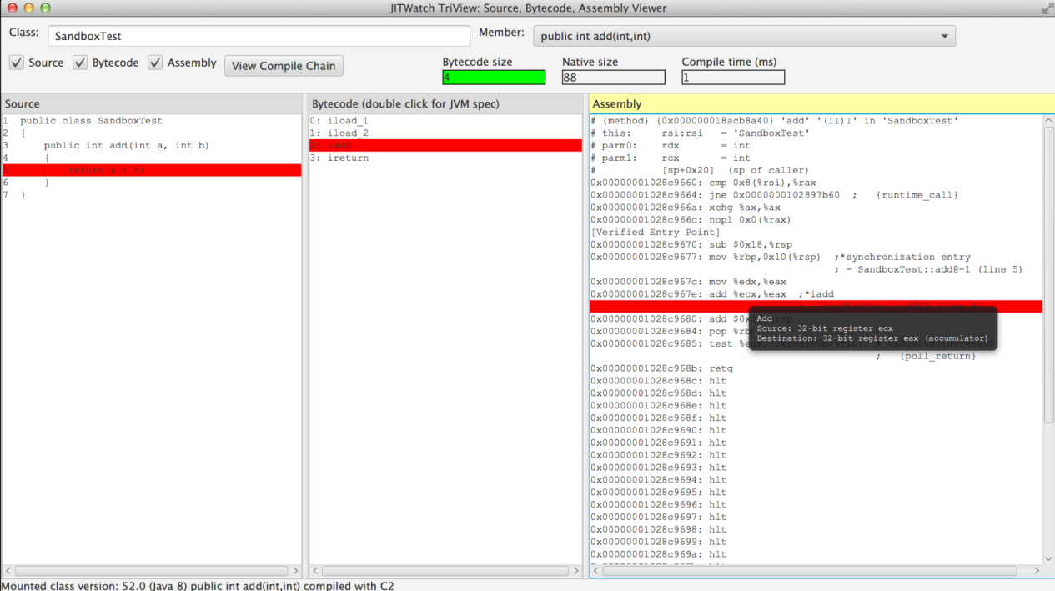
JITWatch
-XX:+UnlockDiagnosticVMOptions -XX:+TraceClassLoading -XX:+LogCompilation

Slide 89
Strategy
Use +XX:+PrintCompilation
Wait until this reaches steady state
Repeat a few runs, and check that the results set is stable
Doubling –XX:ReservedCodeCacheSize, if new methos are now seen to be compiled, so...
Retest overall performance

Slide 90
Execution engine

Slide 91
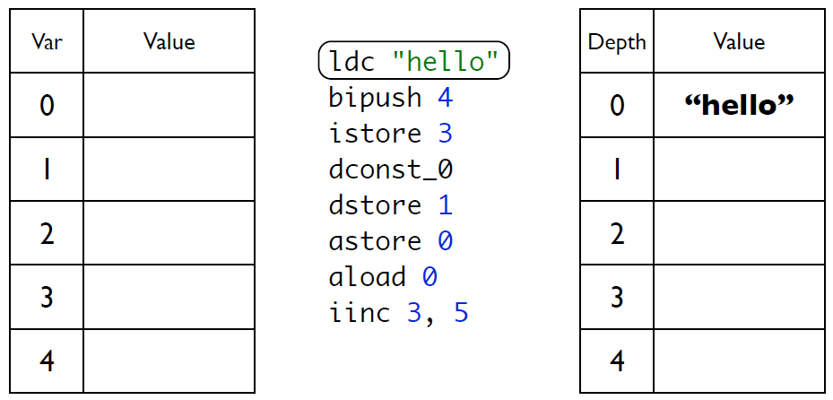
ByteCode ex. Local Variable

Slide 92
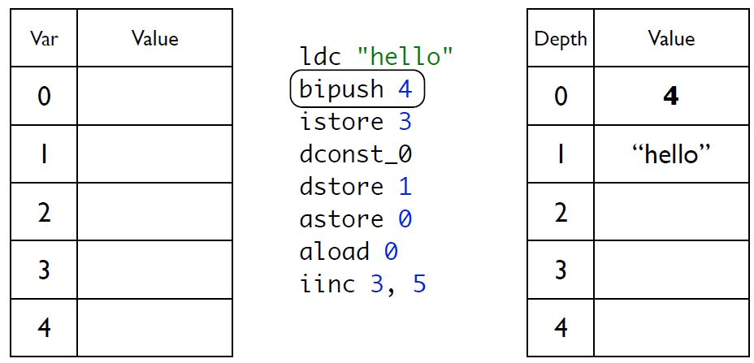
Local Variable

Slide 93
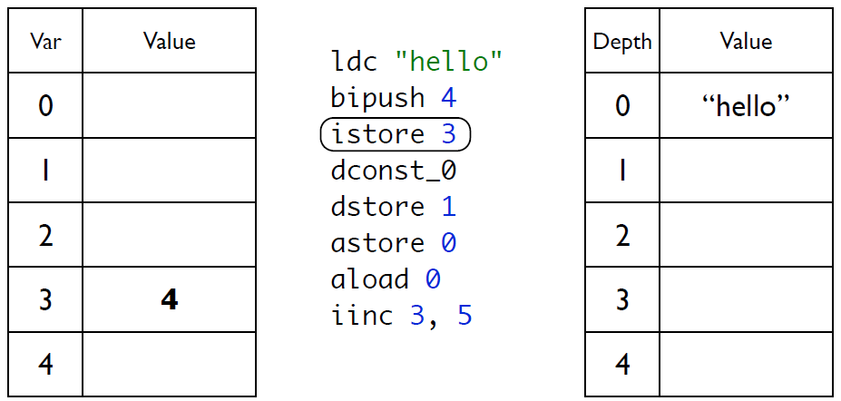
Local Variable

Slide 94
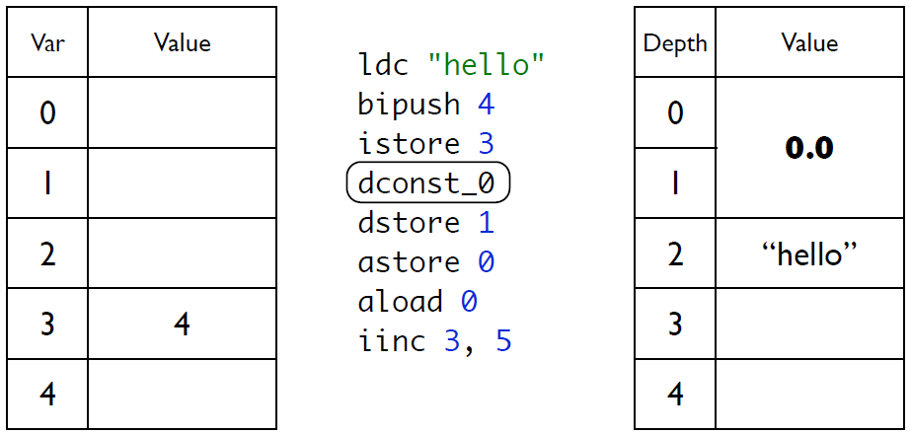
Local Variable

Slide 95
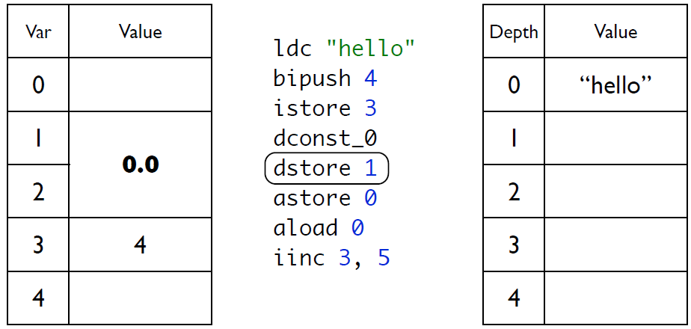
Local Variable

Slide 96
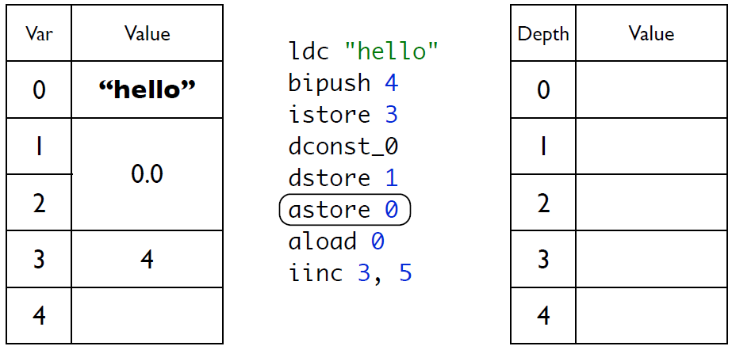
Local Variable

Slide 97
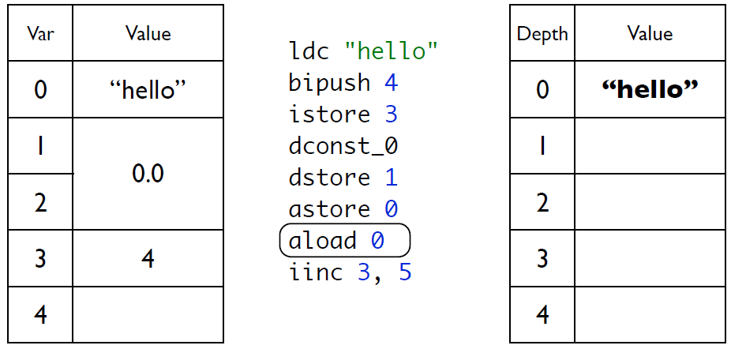
Local Variable

Slide 98
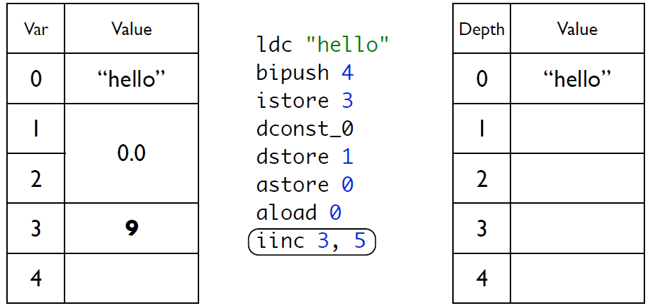
Local Variable

Slide 99
The jdk tools

Slide 100
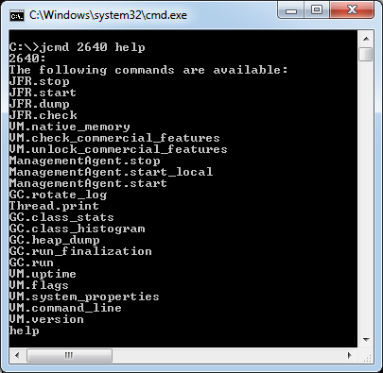
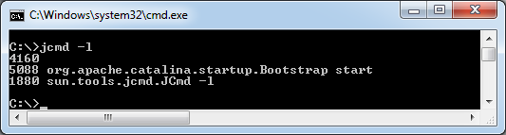

jcmd

Slide 101



JPS

Slide 102



jstat

Slide 103


jdeps

Slide 104


javap

Slide 105


jrunscript

Slide 106


jjs

Slide 107

jconsole

Slide 108

jvisualvm

Slide 109

And...

Slide 110
JVM Flags

Slide 111
Print
-XX:NewSize and -XX:MaxNewSize
-XX:NewRatio
-XX:SurvivorRatio
And so…

Slide 112
MAT and GCMV

Slide 113

Memory Anlyzer Tool

Slide 114

https://www.ibm.com/developerworks/java/jdk/tools/gcmv/#download

Slide 115
Using memory

Slide 116
References
Strong
Weak
Soft
Phanton
-XX:+PrintReferenceGC

Slide 117

Weak

Slide 118

Soft
-XX:SoftRefLRUPolicyMSPerMB=<N>

Slide 119

Soft

Slide 120

Phantom

Slide 121

Finalize - Guardian

Slide 122

FileInputStream

Slide 123

Chain of finalazers

Slide 124
Method factory /Flyweight

Slide 125

No instanciable classes
Math
Arrays
Collections

Slide 126

Lazy initialization

Slide 127

Singleton

Slide 128

Singleton enum

Slide 129

Thread local

Slide 130

String

Slide 131
Micro benchmark
JMH

Slide 132
Examples on JMH
https://github.com/apedrina/altaperformance.git
Jmh project

Slide 133
Application Web performance

Slide 134
TomCat tips
- maxThreads Connecter
Server in front of Tomcat to server static page
autoDeploy=“false“ in production
reloadable=“false“ in production
Compress the output
Combine CSS and JS resources
Produce less whitspace
-Xss – thread stack size

Slide 135
Agent

Slide 136
Aop

Slide 137
Arquitetura
DDD e SOA

Slide 138

Three layers

Slide 139

BoundedContext

Slide 140

Events and jms

Slide 141

Where is the microservices?

Slide 142
Agile manifesto

Slide 143


Slide 144
Scrum

Slide 145


Slide 146
XP

Slide 147
Practices
TDD
Pair Programming
Continuous integration

Slide 148
Clean code

